Slide 1




ICDFA GRC102
Week 4: Monitoring and Auditing Security Controls
Information Security Governance
INTERNATIONAL CYBERSECURITY AND DIGITAL FORENSICS ACADEMY

Slide 2







Learning Objectives
By the end of this week, you will be able to understand and apply key concepts related to monitoring and auditing security controls in an information security governance context.
Continuous Monitoring
Security Metrics
Explain the principles of continuous monitoring and its role in security governance, including key frameworks and methodologies.
Design and implement effective security metrics and key performance indicators (KPIs) to measure security control effectiveness.
Audit Methodologies
Evidence Collection
Apply security audit methodologies to evaluate the implementation and effectiveness of security controls across the organization.
Demonstrate techniques for collecting, analyzing, and documenting audit evidence to support security governance decisions.
Compliance Monitoring
Monitoring Technologies
Develop strategies for monitoring compliance with security policies, standards, and regulatory requirements.
Evaluate security monitoring technologies, including SIEM systems, log management tools, and automation approaches.

Slide 3

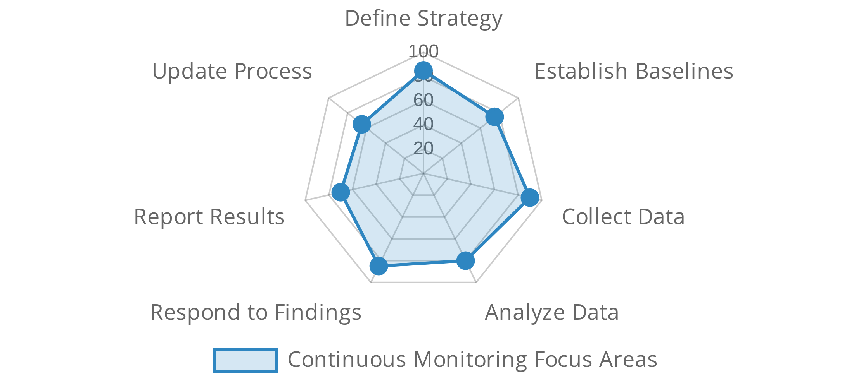












Continuous Monitoring Overview
Continuous monitoring is an ongoing process of maintaining awareness of information security vulnerabilities and threats to support organizational risk management decisions.
Continuous Monitoring Lifecycle
Key Components of Continuous Monitoring
Visibility
- Comprehensive view of security posture across systems
and networks.
Real-time Awareness
- Timely detection of security events and
changes.
Metrics and Measurement
- Quantifiable indicators to assess
control effectiveness.
Automation
- Use of automated tools to collect, analyze, and report
Key Frameworks and Standards
on security data.
NIST SP 800-137
- Information Security Continuous Monitoring
framework.
ISO/IEC 27001:2013
- Monitoring, measurement, analysis
Benefits of Continuous Monitoring
requirements.
Enhanced Security Posture
- Faster identification and remediation
COBIT 2019
- Monitor, Evaluate and Assess (MEA) domain processes.
of weaknesses.
Improved Risk Management
- Better data for risk-based decision
Implementation Challenges
making.
Streamlined Compliance
- Ongoing evidence of compliance with
Resource Intensity
- Requires significant technology and personnel
policies.
resources.
Data Overload
- Managing and analyzing large volumes of security
data.

Slide 4
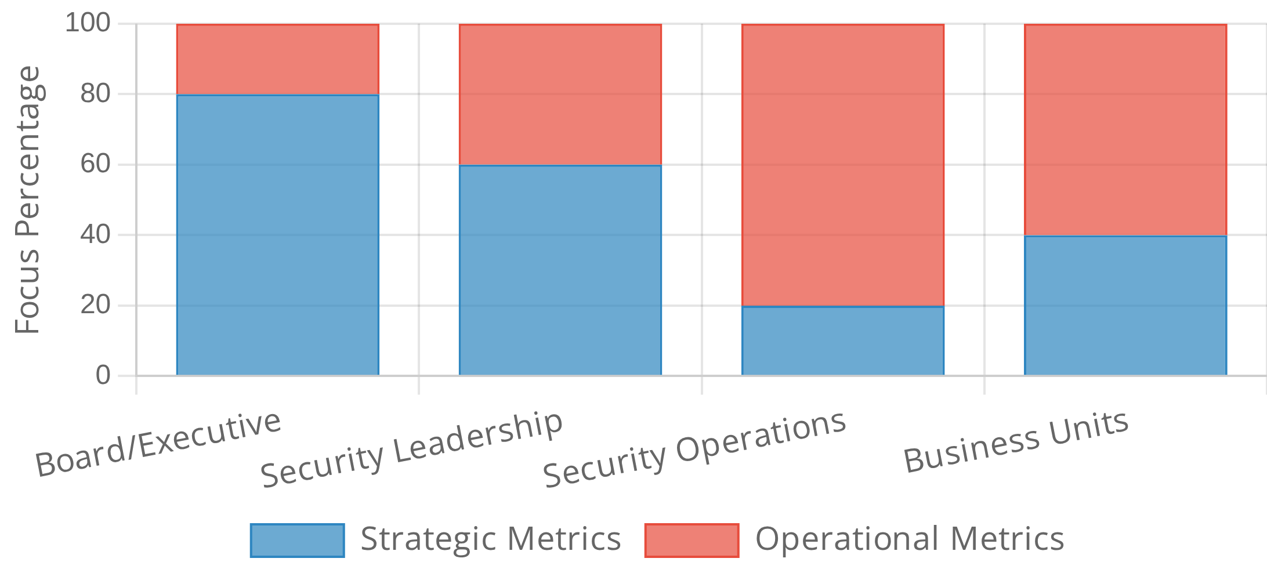













Security Metrics and Measurement
Security metrics provide quantifiable measurements to evaluate the effectiveness of security controls and inform governance decisions.
Security Metrics by Stakeholder Focus
Characteristics of Effective Security Metrics
Relevant
- Aligned with security objectives and business goals
Measurable
- Quantifiable and objective
Actionable
- Provides insights that drive decisions
Repeatable
- Consistently measurable over time
Types of Security Metrics
Implementation Metrics
- Measure deployment of security controls
Effectiveness Metrics
- Measure how well controls are working
Key Performance Indicators (KPIs)
Risk Metrics
- Measure security risk levels
Mean Time to Detect (MTTD)
- Average time to identify security
Compliance Metrics
- Measure adherence to policies and regulations
incidents
Mean Time to Respond (MTTR)
- Average time to contain and
Metrics Implementation Challenges
remediate incidents
Vulnerability Management
- % of critical vulnerabilities remediated
Data Quality
- Ensuring metrics are based on accurate, complete
within SLA
data
Context
- Providing sufficient context for meaningful interpretation

Slide 5









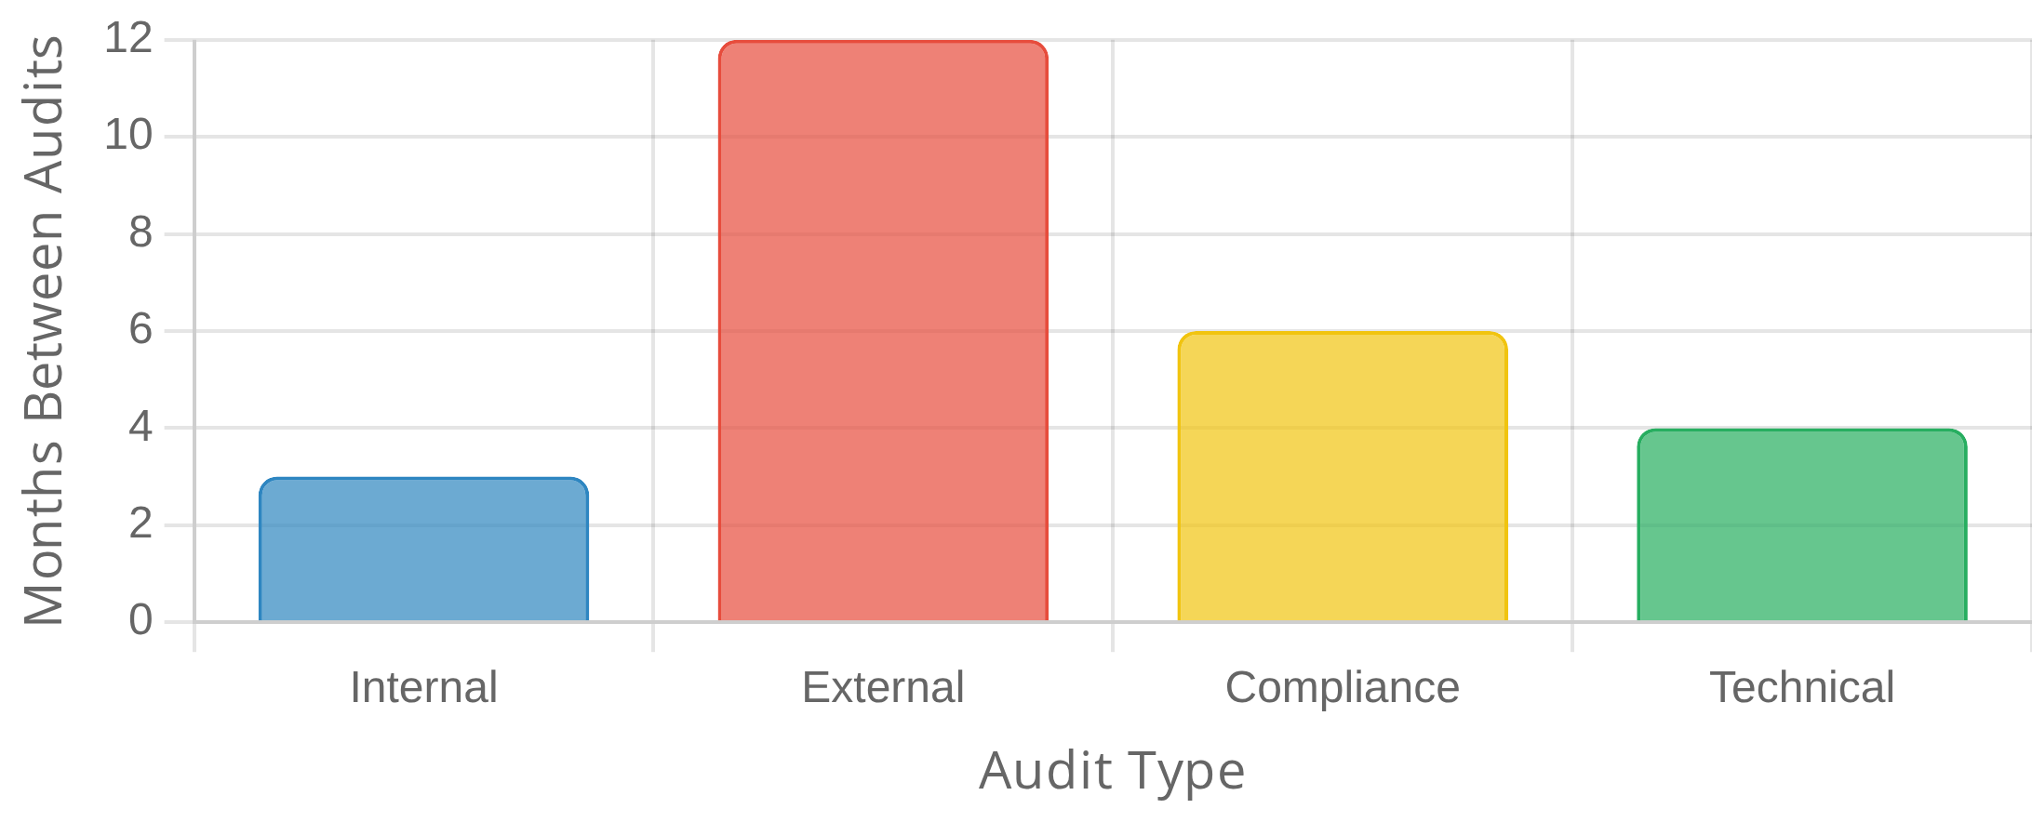

Security Auditing Fundamentals
Security auditing is a structured process of examining and evaluating an organization's security controls to determine their effectiveness and compliance with policies.
Key Audit Principles
Independence
- Auditors must be independent of the activities
being audited.
Evidence-Based
- Findings must be based on verifiable evidence
Types of Security Audits
rather than assumptions.
Internal Audits
- Conducted by organization's own audit team to
Sampling
- Using representative samples to draw conclusions about
assess control effectiveness.
larger populations.
External Audits
- Performed by independent third parties to provide
Risk-Based
- Focus audit resources on areas of highest risk to the
objective assessment.
organization.
Compliance Audits
- Focus on adherence to specific regulatory
requirements (e.g., HIPAA, PCI DSS).
Security Audit Process
Planning
- Define scope, objectives, criteria, and methodology.
Security Audit Frequency by Type
Fieldwork
- Collect evidence through interviews, documentation
review, and testing.
Analysis
- Evaluate evidence against audit criteria to identify gaps
and issues.
Reporting
- Document findings, recommendations, and required
actions.
Common Audit Standards
ISO 19011
- Guidelines for auditing management systems
ISACA COBIT
- Control Objectives for Information Technologies

Slide 6






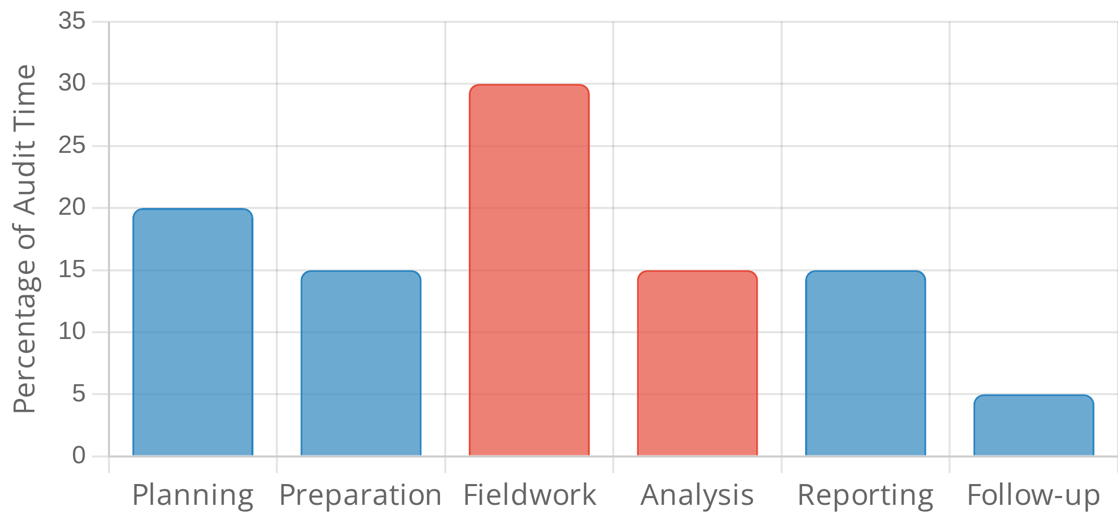


Audit Planning and Preparation
Effective security audit planning establishes the foundation for successful audits by defining scope, objectives, and methodologies before execution begins.
Audit Documentation
Audit Charter
- Formal document authorizing the audit and
defining its purpose, authority, and responsibilities.
Audit Plan
- Detailed document outlining scope, objectives,
Key Planning Steps
timeline, resources, and methodologies.
Audit Program
- Step-by-step procedures for conducting the audit,
Define Audit Objectives
- Clearly articulate what the audit aims to
including testing methods and evidence requirements.
achieve and which security controls will be assessed.
Notification Letters
- Communications to stakeholders about the
Determine Scope
- Identify systems, processes, and organizational
upcoming audit, its scope, and requirements.
units to be included in the audit.
Select Audit Criteria
- Choose the standards, frameworks, or
policies against which controls will be evaluated.
Risk-Based Audit Planning
Assemble Audit Team
- Identify team members with appropriate
Risk Assessment
- Identify high-risk areas that require more
skills and ensure independence from the areas being audited.
intensive audit focus.
Audit Planning Timeline
Control Prioritization
- Focus on controls that mitigate the most
significant risks to the organization.
Resource Allocation
- Assign audit resources based on risk levels
and control criticality.
Preparation Best Practices
Preliminary Research
- Review previous audit findings,
documentation, and known issues before fieldwork begins.
Stakeholder Engagement
- Involve key stakeholders early to gain
buy-in and ensure cooperation.
Tool Preparation
- Ensure all necessary audit tools, templates, and
checklists are ready before fieldwork.

Slide 7










Audit Execution Techniques
Effective security audit execution requires a structured approach and appropriate techniques to gather reliable evidence about control effectiveness.
Testing Approaches
Sampling
- Selecting a representative subset of items to test when
the population is too large to test completely.
Automated Testing
- Using tools to automatically test technical
Key Audit Techniques
controls, such as vulnerability scanners or configuration analyzers.
Penetration Testing
- Simulating attacks to identify vulnerabilities
Observation
- Watching processes being performed to verify they
in systems or processes that could be exploited.
follow documented procedures and controls.
Process Walkthroughs
- Following a transaction or process from
Interviews
- Structured conversations with personnel to
beginning to end to verify controls are applied consistently.
understand processes, responsibilities, and control awareness.
Documentation Review
- Examining policies, procedures, and
records to verify they exist, are current, and are followed.
Best Practices for Audit Execution
Testing
- Performing specific tests to verify control implementation
Use Standardized Checklists
- Develop and use standardized audit
and effectiveness.
checklists to ensure consistency and completeness.
Maintain Independence
- Ensure auditors are independent from
the areas being audited to avoid conflicts of interest.
Common Challenges
Document Everything
- Maintain detailed documentation of all
Limited Access
- Difficulty obtaining access to systems, personnel,
audit activities, findings, and evidence.
or documentation needed for the audit.
Involve Subject Matter Experts
- Include technical experts when
Time Constraints
- Pressure to complete audits quickly, potentially
auditing specialized areas or complex controls.
compromising thoroughness.

Slide 8







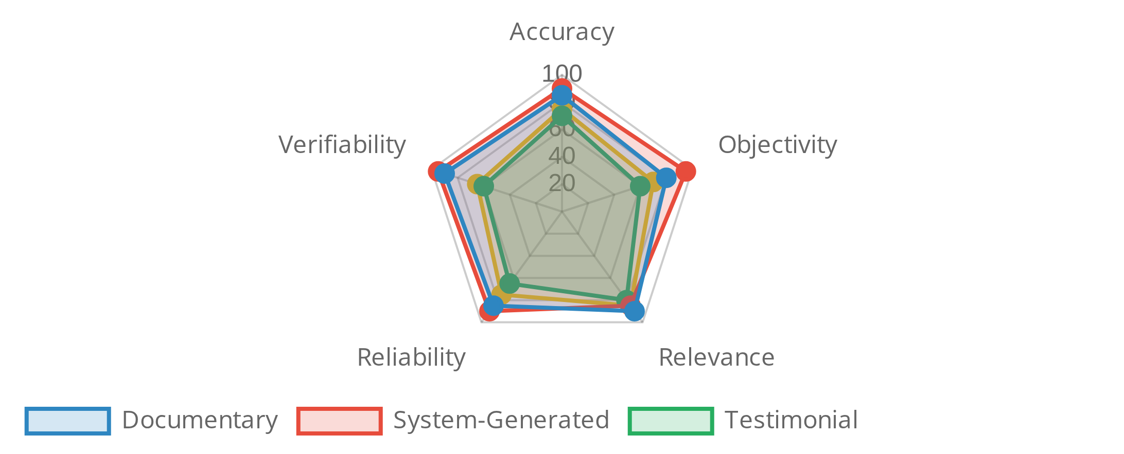

Evidence Collection and Analysis
Evidence collection and analysis are critical components of security auditing, providing the factual basis for audit findings and recommendations.
Evidence Collection Best Practices
Chain of Custody
- Maintain proper documentation of how evidence
was collected and handled.
Types of Audit Evidence
Sufficient Sample Size
- Collect enough samples to draw valid
conclusions.
Documentary Evidence
- Policies, procedures, logs, and written
Multiple Sources
- Gather evidence from multiple sources to
records.
corroborate findings.
System-Generated Evidence
- Configuration settings, system logs,
and automated reports.
Testimonial Evidence
- Information obtained through interviews
Evidence Analysis Techniques
and surveys.
Observational Evidence
- Direct observations of processes and
Trend Analysis
- Examining patterns and trends in data over time.
controls in operation.
Root Cause Analysis
- Identifying underlying causes of control
failures.
Compliance Mapping
- Comparing evidence against compliance
Evidence Reliability by Type
requirements.
Gap Analysis
- Identifying differences between expected and actual
control state.
Common Challenges
Incomplete Evidence
- Missing or partial evidence that makes it
difficult to draw conclusions.
Conflicting Evidence
- Different evidence sources providing
contradictory information.

Slide 9









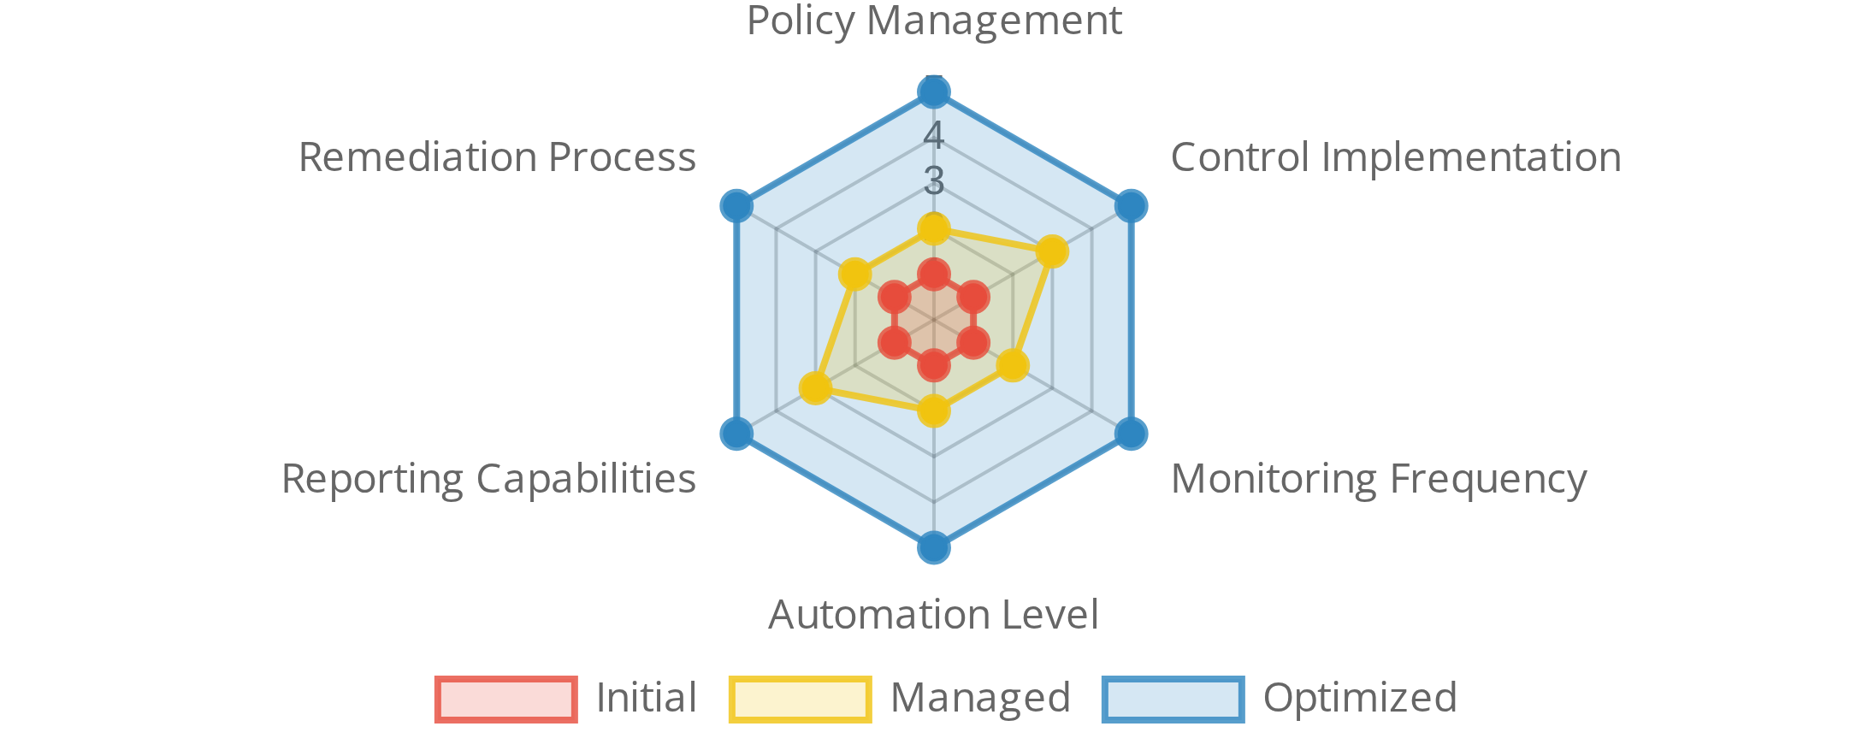

Compliance Monitoring and Reporting
Compliance monitoring is the ongoing process of evaluating adherence to security policies, standards, and regulatory requirements to ensure continued compliance.
Compliance Reporting Best Practices
Audience-Focused
- Tailor reports to different stakeholders' needs.
Visual Representation
- Use charts and dashboards to present
Key Components of Compliance Monitoring
compliance status.
Control Assessment
- Regular evaluation of security controls to
Risk-Based Prioritization
- Highlight compliance gaps based on risk.
verify effectiveness.
Metrics Collection
- Gathering quantifiable data on compliance
Continuous Compliance Monitoring
status.
Gap Analysis
- Identifying areas where compliance requirements are
Real-time Monitoring
- Automated tools that continuously assess
not being met.
compliance status.
Automated Testing
- Scheduled scripts that verify control
implementation.
Compliance Monitoring Maturity Model
Alerting
- Notifications when compliance status changes or controls
fail.
Key Compliance Metrics
Compliance Rate
- Percentage of requirements that are fully
satisfied.
Control Failures
- Number of controls that failed testing or
assessment.

Slide 10








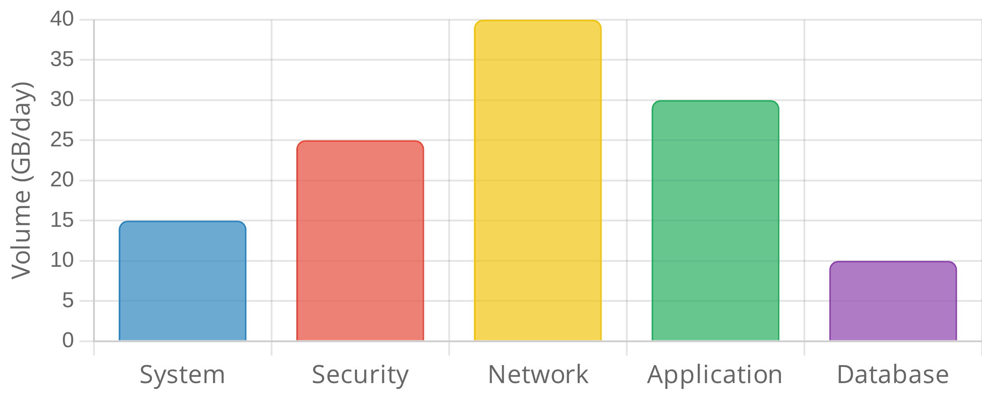





Log Management and Analysis
Log management is the process of collecting, storing, analyzing, and monitoring log data generated by systems, applications, and devices to support security monitoring and auditing.
Log Management Lifecycle
Generation & Collection
- Configuring systems to generate logs and
collecting them
Key Log Sources
Normalization & Parsing
- Converting logs to a standard format
System Logs
- Operating system events and system changes
Storage & Retention
- Securely storing logs for required periods
Security Logs
- Authentication attempts and security alerts
Analysis & Correlation
- Examining logs to identify patterns and
events
Network Logs
- Firewall, router, and network traffic information
Application Logs
- Application-specific events and user activities
Log Analysis Techniques
Log Volume by Source (Average Daily)
Pattern Recognition
- Identifying known patterns indicating security
events
Anomaly Detection
- Identifying deviations from normal behavior
Event Correlation
- Connecting related events across multiple log
sources
Best Practices
Time Synchronization
- Ensure all systems use synchronized time
sources
Log Integrity
- Protect logs from unauthorized modification
Filtering Strategy
- Balance between collecting too much data and
missing events

Slide 11











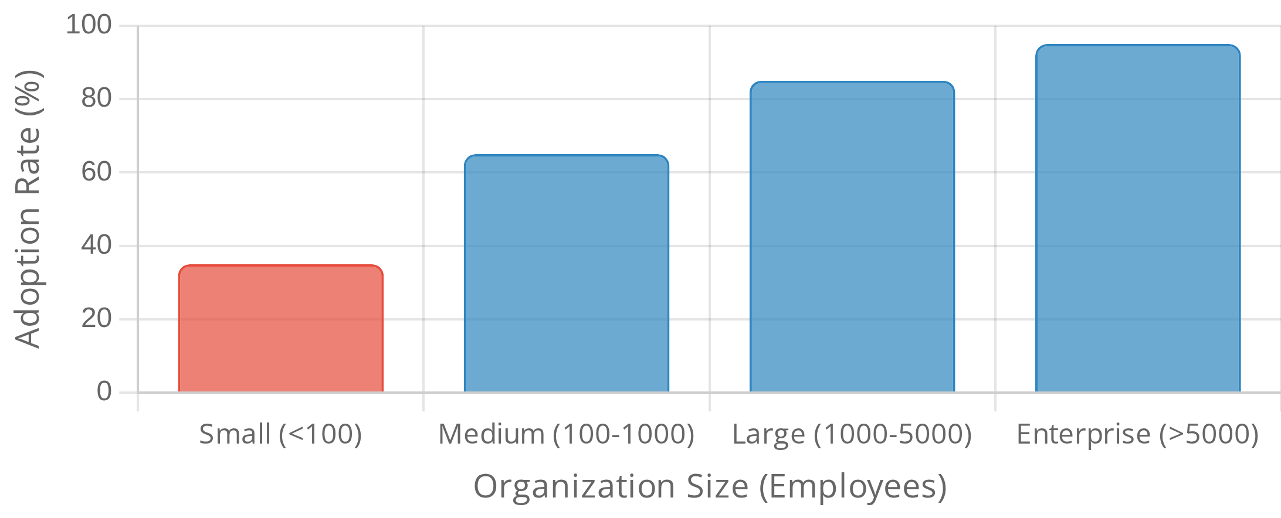



SIEM and Monitoring Technologies
Security Information and Event Management (SIEM) systems collect, analyze, and correlate security event data from multiple sources to support threat detection, incident response, and compliance monitoring.
Modern SIEM Enhancements
User & Entity Behavior Analytics (UEBA)
- Machine learning
algorithms that detect anomalous user and system behaviors
Security Orchestration & Response (SOAR)
- Automated incident
Core SIEM Capabilities
response workflows and playbooks
Cloud Integration
- Monitoring cloud environments and SaaS
Log Collection & Aggregation
- Gathering security event data from
applications
diverse sources across the organization
Big Data Architecture
- Scalable platforms for processing massive
Normalization & Parsing
- Converting varied log formats into a
volumes of security data
standardized structure for analysis
Correlation & Analysis
- Identifying relationships between events
across different systems
Complementary Monitoring Technologies
Alerting & Notification
- Generating alerts for security incidents
based on predefined rules
Network Traffic Analysis (NTA)
- Monitoring network traffic
Dashboards & Reporting
- Visualizing security data and generating
patterns to detect anomalies and threats
compliance reports
Endpoint Detection & Response (EDR)
- Monitoring and
responding to suspicious activities on endpoints
Vulnerability Scanners
- Identifying security vulnerabilities in
SIEM Adoption by Organization Size
systems and applications
Threat Intelligence Platforms
- Integrating external threat data to
enhance detection capabilities
Implementation Considerations
Use Case Development
- Define specific security monitoring
scenarios aligned with organizational risks
Tuning & Optimization
- Refine rules and thresholds to reduce false
positives and improve detection
Staffing & Expertise
- Ensure adequate skilled personnel to operate
and maintain the SIEM

Slide 12






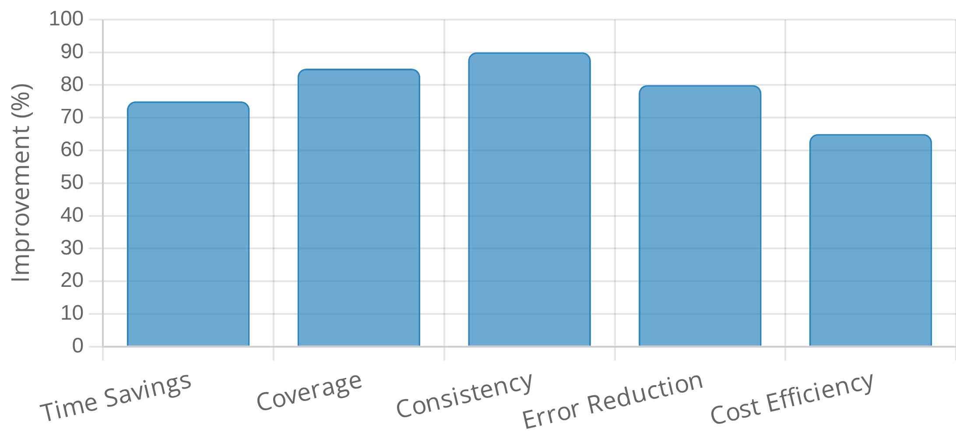


Automation in Monitoring and Auditing
Automation enhances security monitoring and auditing by increasing efficiency, consistency, and coverage while reducing human error and resource requirements.
Automated Monitoring Capabilities
Continuous Control Monitoring
- Real-time verification of security
control effectiveness and configuration.
Key Automation Technologies
Automated Alerting
- Immediate notifications when security events
or compliance violations occur.
Robotic Process Automation (RPA)
- Software robots that mimic
Trend Analysis
- Automated identification of patterns and trends in
human actions to perform repetitive audit tasks.
security data over time.
Machine Learning
- Algorithms that learn from data to identify
Automated Reporting
- Generation of compliance and security
patterns, anomalies, and potential security issues.
reports without manual intervention.
Scripting & APIs
- Custom scripts and API integrations that
automate data collection and analysis.
Orchestration Tools
- Platforms that coordinate multiple automated
Automated Audit Processes
processes across different systems.
Control Testing
- Automated scripts that verify control
implementation and effectiveness.
Automation Impact on Monitoring & Auditing
Data Sampling & Analysis
- Automated selection and examination of
representative data samples.
Configuration Assessment
- Automated comparison of system
configurations against security baselines.
Workflow Automation
- Automated management of audit tasks,
schedules, and follow-ups.
Implementation Challenges
Initial Investment
- High upfront costs for automation tools and
implementation.
Integration Complexity
- Challenges in connecting diverse systems
and data sources.
False Positives
- Risk of automated systems generating excessive
alerts or findings.

Slide 13






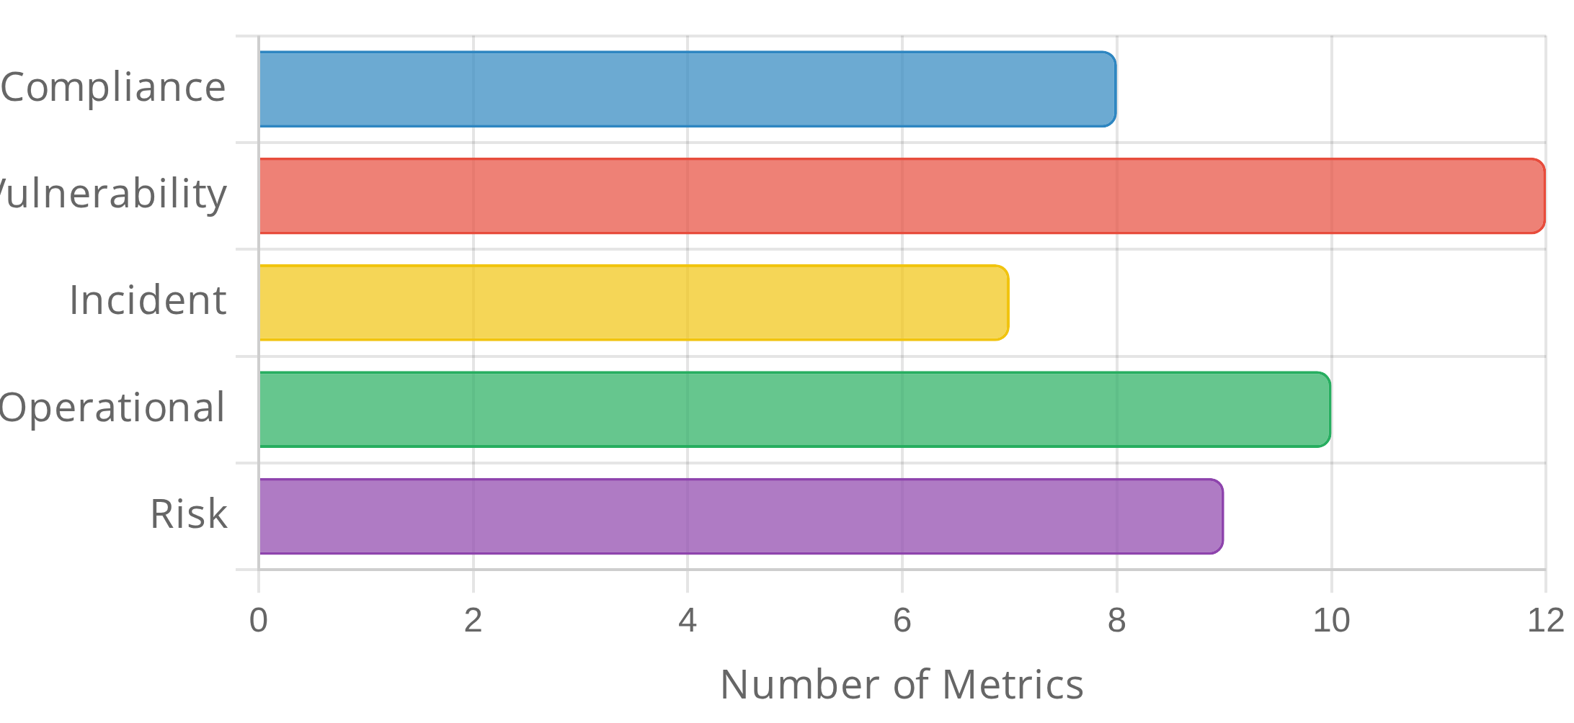
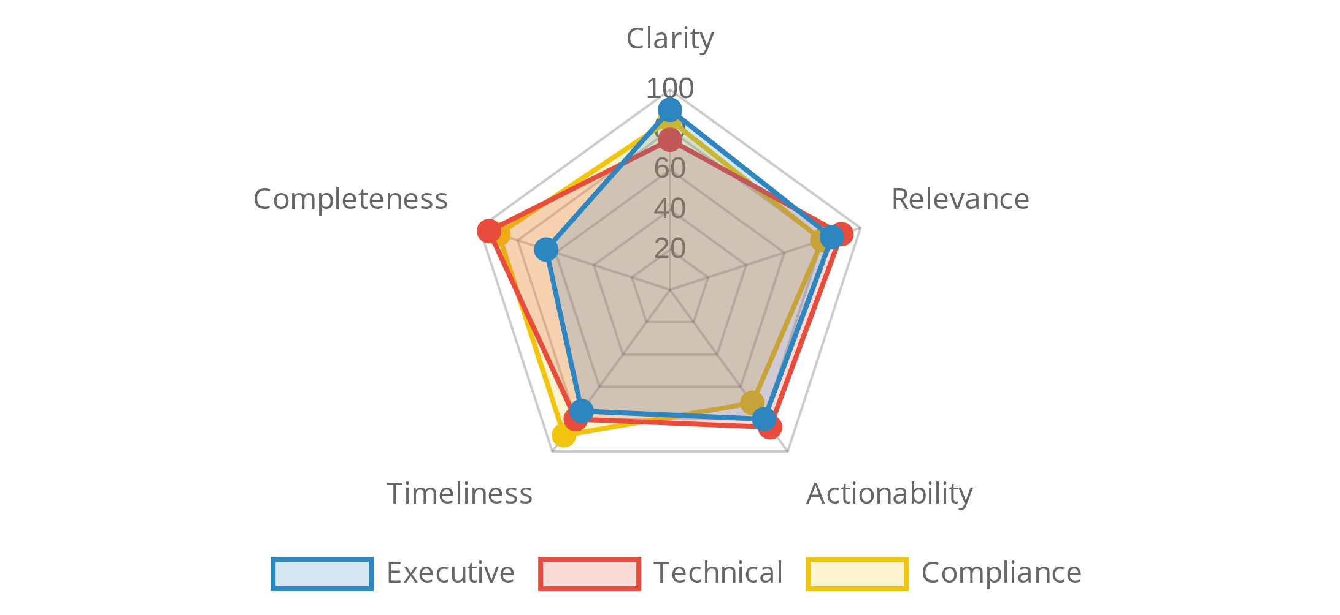


Security Reporting and Dashboards
Effective security reporting and dashboards transform complex security data into actionable insights, supporting decision-making, demonstrating compliance, and communicating security status to stakeholders.
Types of Security Reports
Compliance Reports
- Document adherence to regulatory
requirements and internal policies.
Security Posture Reports
- Provide an overview of the organization's
Key Reporting Principles
security status and risk exposure.
Vulnerability Reports
- Detail identified vulnerabilities, their
Audience-Focused
- Tailor content, detail level, and format to the
severity, and remediation status.
specific audience (executives, technical teams, regulators).
Incident Reports
- Document security incidents, response actions,
Visual Clarity
- Use appropriate visualizations to communicate
and lessons learned.
complex information effectively.
Operational Reports
- Track security operations activities and
Risk-Based Context
- Present security metrics in the context of
performance metrics.
business risk and impact.
Trend Analysis
- Show changes over time to identify patterns and
progress.
Key Security Metrics by Category
Dashboard Effectiveness by Audience
Dashboard Design Best Practices
Layered Information
- Provide high-level summaries with drill-down
capabilities for details.
Consistent Visual Language
- Use consistent colors, icons, and
layouts to enhance comprehension.
Real-Time Updates
- Implement automated data refreshes to
ensure current information.

Slide 14







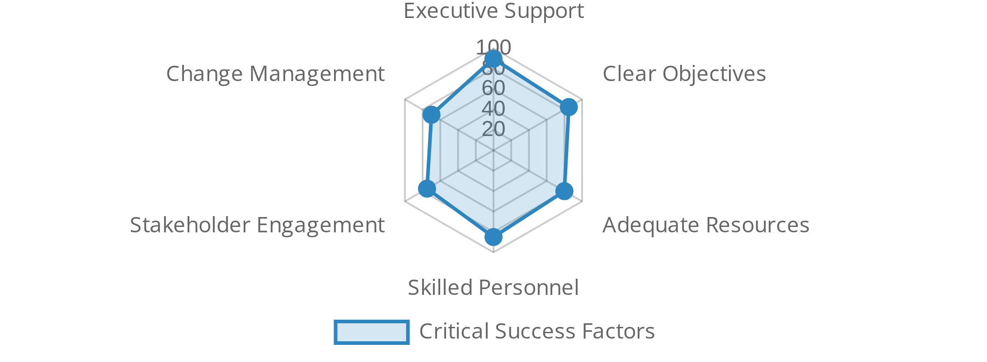
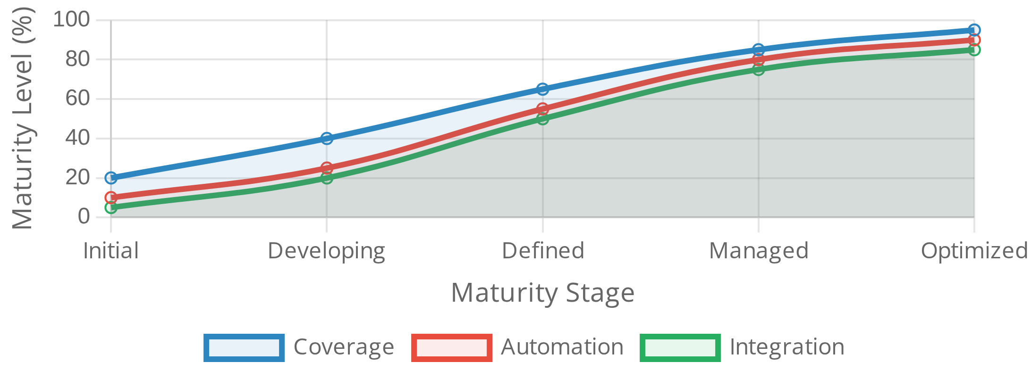
Continuous Improvement in Monitoring and Auditing
Continuous improvement is essential for maintaining effective security monitoring and auditing programs in the face of evolving threats, technologies, and business requirements.
Key Improvement Focus Areas
Coverage Expansion
- Extending monitoring to new systems and
environments.
The Continuous Improvement Cycle
Detection Enhancement
- Improving identification of security
events.
Assess
- Evaluate current monitoring and auditing capabilities
Response Time Reduction
- Decreasing time between detection and
against requirements.
remediation.
Plan
- Develop improvement strategies based on risk and value.
Automation Expansion
- Increasing automation in monitoring
Implement
- Execute improvement initiatives and changes.
processes.
Measure
- Track performance metrics to evaluate effectiveness.
Refine
- Adjust approaches based on results and lessons learned.
Improvement Initiative Success Factors
Monitoring Program Maturity Evolution

Slide 15





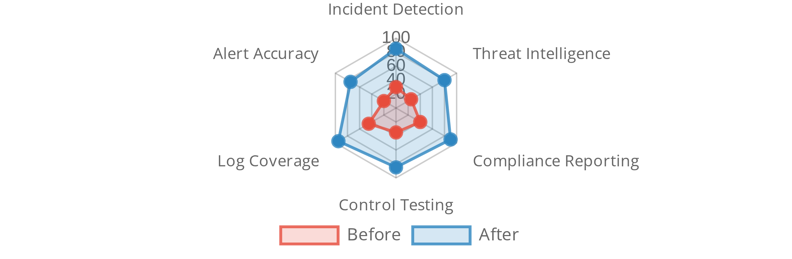
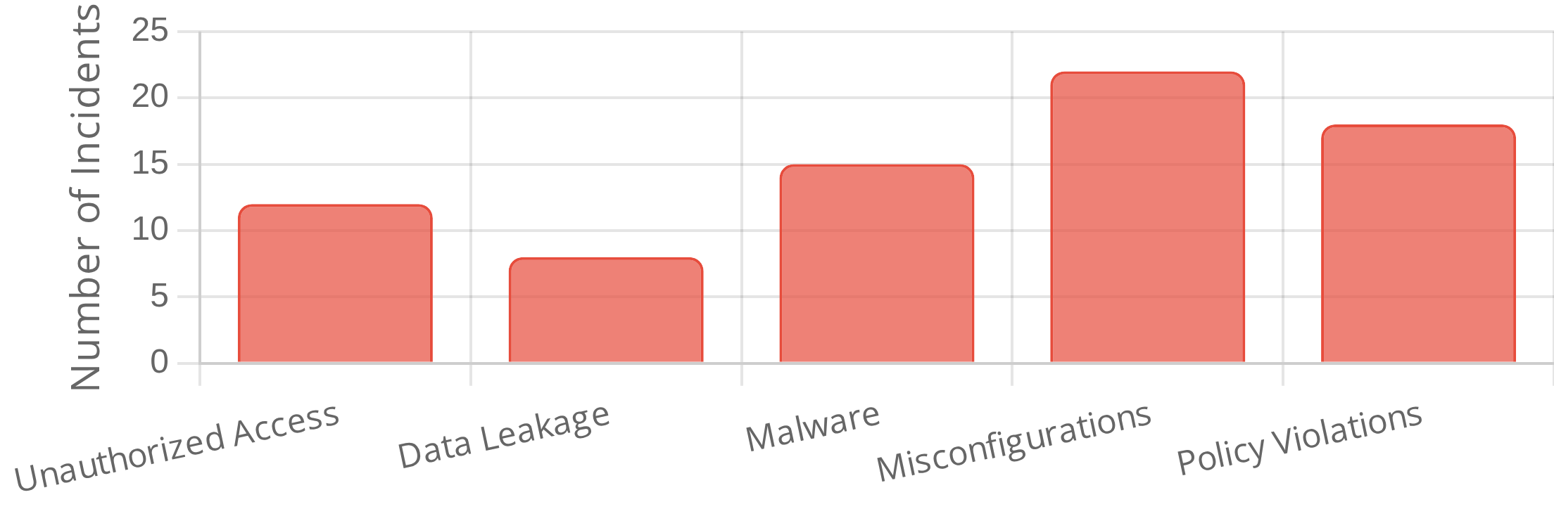


Case Study: Effective Security Monitoring
This case study examines how a financial services organization implemented a comprehensive security monitoring program to address regulatory requirements.
Implementation Approach
Phase 1: Assessment & Planning
- Review of existing controls
Phase 2: SIEM Implementation
- Enterprise SIEM deployment
Organization Background
Phase 3: Continuous Monitoring
- Automated alerting
Mid-sized financial services company
with 2,500 employees
Phase 4: Audit Automation
- Automated compliance reporting
Operations in 5 countries
with distributed IT infrastructure
Subject to multiple regulations
including PCI DSS, SOX, and GDPR
Key Outcomes
85% reduction in incident detection time
(from 72+ to <10 hours)
Initial Challenges
65% decrease in audit preparation effort
through automation
Siloed monitoring systems
with no centralized visibility
40% reduction in security incidents
through improved detection
Manual audit processes
consuming significant resources
Delayed detection
of security incidents (average 72+ hours)
Monitoring Effectiveness Improvement
Security Incidents Before Implementation
Key Lessons Learned
Executive sponsorship
was critical for cross-departmental
cooperation
Phased implementation
allowed for adjustment and refinement

Slide 16















Summary and Key Takeaways
This week, we explored the critical aspects of monitoring and auditing security controls, which form the foundation of effective security governance and compliance management.
Monitoring Maturity Journey
Ad-hoc (Level 1)
- Reactive monitoring with minimal automation and
limited coverage.
Key Takeaways
Defined (Level 3)
- Standardized monitoring processes with
moderate automation and broader coverage.
Continuous Monitoring is Essential
- Security controls must be
Optimized (Level 5)
- Comprehensive, risk-based monitoring with
continuously monitored to ensure ongoing effectiveness and
extensive automation and continuous improvement.
compliance.
Evidence-Based Approach
- Effective auditing requires systematic
collection and analysis of evidence to verify control implementation.
Technology Enablement
- SIEM systems and other monitoring
Next Steps and Application
technologies provide the foundation for effective security
Assess Your Current State
- Evaluate your organization's monitoring
monitoring.
and auditing capabilities.
Automation Drives Efficiency
- Automated processes increase
Develop a Roadmap
- Create a plan to enhance capabilities based
coverage, consistency, and cost-effectiveness.
on identified gaps.
Implement Quick Wins
- Identify and implement high-impact, low-
effort improvements.
Critical Success Factors
Prepare for Next Week
- We will explore case studies in security
Leadership Support
- Executive sponsorship and commitment to
governance.
monitoring and auditing activities.
Risk-Based Approach
- Focusing monitoring and auditing efforts on
the most critical risks and controls.
Value Proposition
Continuous Improvement
- Regular refinement of monitoring
Risk Reduction
- Earlier detection of security issues reduces
processes based on results and changing threats.
potential impact.
Compliance Assurance
- Demonstrable evidence of control
effectiveness for regulators.
Operational Efficiency
- Automation reduces manual effort and
improves resource allocation.

